Slide 1

Lecture 6:
Functions, Modules, Libraries, Packages
CoTaPP: Computational Thinking and
Programming with Python
All icons by: https://www.flaticon.com/

Slide 2

Previous lecture
Loops (repetitive behavior):
  while
  for
  break
  continue
Post-test loops in Python

Slide 3



Slide 4
Today’s lecture
Functions, modules and packages
  functions allow you to reuse already existing functionality (rather than implementing it again)
  modules and packages allows you to logically organize your Python code
Recursion
  A method of solving a computational problem where the solution depends on solutions to smaller instances of the same problem

Slide 5


Slide 6
To Do
Exercises for the week
  Use quarterfall to submit them
Work in Project 1 (just a few more days)
StudyLens

Slide 7
Next lecture
Data structures in Python
  more powerful data items than just the individual values

Slide 8

Next lecture
Data structures in Python
  more powerful data items than just the individual values

Slide 9
Next lecture
Recursion
  a method of solving a computational problem where the solution depends on solutions to smaller instances of the same problem

Slide 10
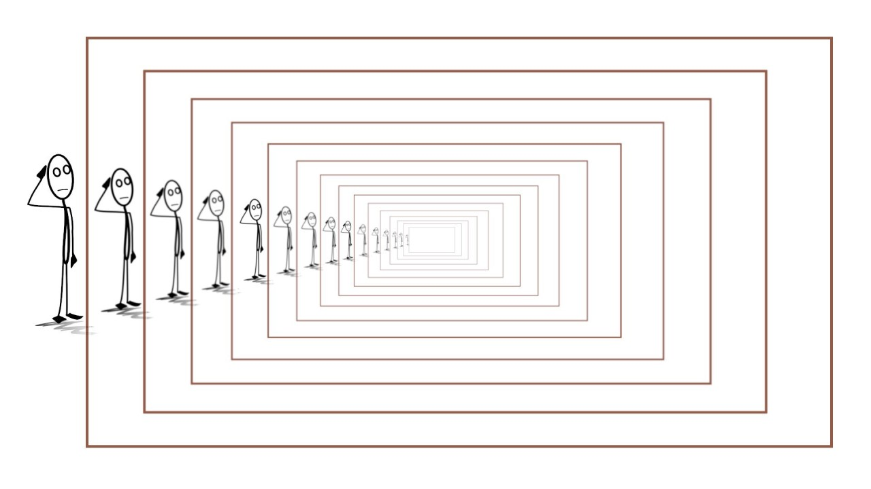
Next lecture
Recursion
  a method of solving a computational problem where the solution depends on solutions to smaller instances of the same problem
  “In order to understand recursion, one must first understand recursion.”

